Slide 1
Hydrogen Policy in Ireland
Spine H2 - IRL Webinar
15th September 2023

Slide 2

Policy Context – Hydrogen in Ireland
Ireland currently has very little existing hydrogen production or demand – the starting point for our hydrogen sector will be different as limited industrial demand for immediate use exists today, compared to other jurisdictions.
Ireland has a strategic opportunity to produce renewable hydrogen at scale, with potential to produce more than our own indigenous needs.
The Government is committed to the continued support for the establishment of a sustainable renewable hydrogen industry in Ireland, which is closely integrated with our overarching energy, economic and climate goals.

Slide 3
Policy Drivers for the National Hydrogen Strategy
  Supports decarbonisation of our energy sector
    Renewable “Green” Hydrogen offers a zero-carbon renewable fuel which can be targeted to hard to decarbonise sectors where electrification is not feasible or cost effective
  Enhances our energy security
    In 2021, Ireland imported 77% of its energy needs - Renewable hydrogen offers a pathway to greater energy independence
  Creates potential industrial opportunities
    Renewable Hydrogen potentially offers industrial opportunities for Ireland in the long term through the creation of new markets such as Exports, Sustainable Aviation and Maritime Fuels etc., and the potential to attract new industry with a cheap secure supply of green energy
Industrial Opportunities
Energy Security
Decarbonisation

Slide 4

The National Hydrogen Strategy 2023
  Sets out the long-term vision for hydrogen in Ireland
  Considers the entire value chain including production, end uses, infrastructure needs, regulation and safety, as well as innovation and partnerships
  Includes a list of 21 actions which are set across the entire hydrogen value chain, in the aim of facilitating early action in the sector on low regrets aspects / knowledge development
  Ultimately, the strategy is our first national policy in the space and will help to create the initial building blocks which can drive the certainty needed for private investment in the sector

Slide 5
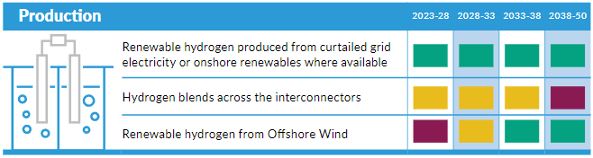
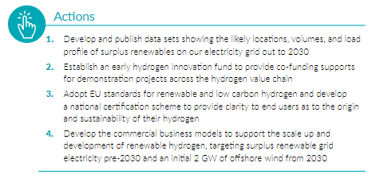
Hydrogen Production
Ireland will prioritise the scale up and production of renewable hydrogen.
Prior to 2030, hydrogen will be produced from grid connected electrolysis from surplus renewables.
The operating models for these should be beneficial to the electricity system
A 2 GW target of offshore wind earmarked for renewable hydrogen production to be in development by 2030
Ireland has one of the best offshore wind resources globally and has the potential to develop a decarbonised industrial opportunity in proximity to this resource, and to become a net exporter

Slide 6
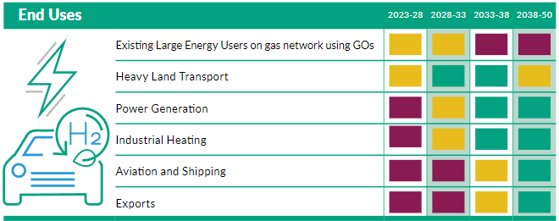
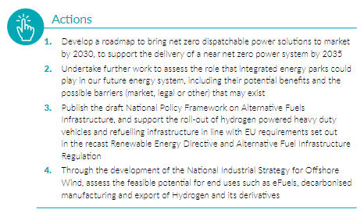
Hydrogen End-Uses
The deployment of renewable hydrogen in Ireland will focus on hard-to-decarbonise sectors where energy efficiency and direct electrification are not feasible or cost-effective solutions.
Heavy duty transport applications are anticipated to be the first end-use sectors to develop, followed closely by industry and flexible power generation.
Aviation and maritime are expected to be large high priority end-users but these sectors will take longer to develop.
Future work is needed to better understand the needs of potential end-use sectors, and the role that renewable hydrogen can play in an integrated net zero energy system

Slide 7
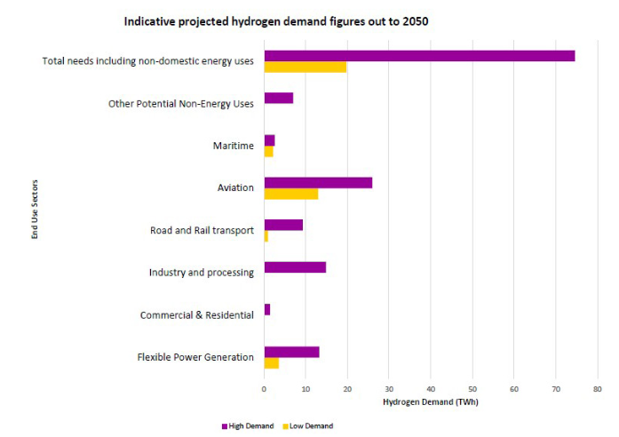
Hydrogen End Uses
Indicative projections estimate that Ireland’s domestic hydrogen energy demand needs could equate to between 4.6 and 39 TWh by 2050.
When including non-domestic energy needs such as International Aviation and Shipping, these values could rise to between 19.8 to 74.6 TWh.
This wide range demonstrates the significant uncertainties which exist due to the nascent nature of the market.

Slide 8
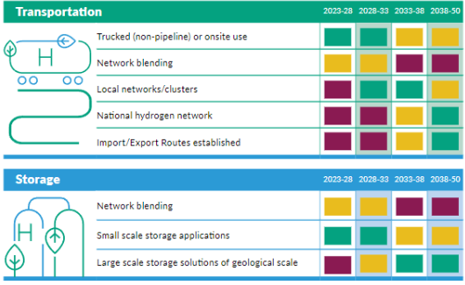
Transportation & Storage (1)
  Hydrogen networks will take time to develop. Initial hydrogen applications are therefore likely to utilise compressed tankering solutions.
  Hydrogen networks will be more efficient as the sector develops. Infrastructure is expected to roll out initially across a small number of regional clusters where production, high priority demand and large-scale storage are co-located.
  Where feasible, repurposing existing natural gas pipeline infrastructure to hydrogen is favourable.
  A network transition plan should be developed to determine how the existing gas network pipelines can be repurposed to support the needs of the hydrogen sector, whilst taking due consideration of existing needs

Slide 9
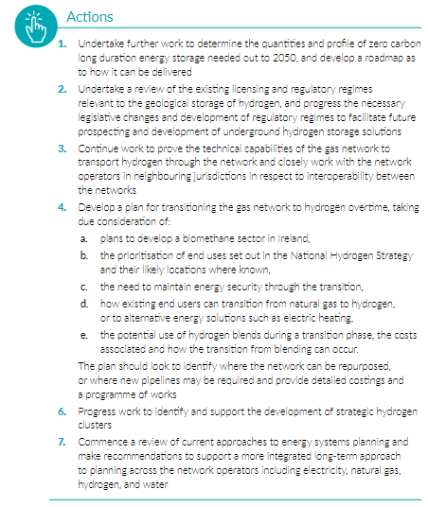
Transportation & Storage (2)
  Networks and storage infrastructure, as well as interconnection import/export routes, will play a key role in ensuring security and price resilience of supply.
  Long duration storage in particular will be essential to the future cost competitiveness and price resilience of hydrogen.
  Geological storage solutions will be needed to support this. Developing the necessary regulatory and legislative changes to facilitate exploration and development of potential storage solutions will be needed to enable this.
  The potential use of hydrogen blending during a transitional phase requires careful consideration, and should only be viewed as a temporary measure whilst dedicated infrastructure develops

Slide 10
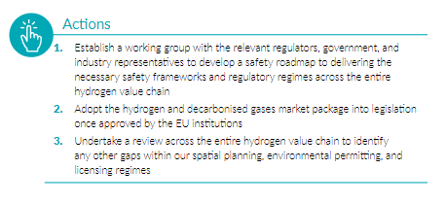
Hydrogen Safety & Regulation
Hydrogen safety is essential, and early focus is needed to develop a safety roadmap to delivering the necessary safety frameworks and regulatory regimes across the entire hydrogen value chain.
The EU Hydrogen and Decarbonised Gas Market Package sets out the regulatory market rules for scaling up hydrogen and the development of dedicated hydrogen infrastructures. Ireland should adopt the outcomes of this in a timely manner.
Renewable and low carbon hydrogen will be defined in line with EU regulations, and a certification scheme should be established to reflect these definitions, providing certainty to end users as to the origin and sustainability of their hydrogen.

Slide 11
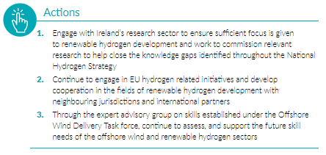
Hydrogen Research & Development And International Cooperation
Renewable hydrogen is still a nascent technology. Global research and innovation over the coming years will be essential to future competitiveness and scale up.
Targeted, short-term research needs have been identified throughout the National Hydrogen Strategy which will be essential to ensuring future informed policy making in the space.
Leveraging EU hydrogen R&D resources and applying them to Ireland will be important.
Building strategic international partnerships will be an important enabler.
Work is needed to determine the skills required, short falls and the opportunities for employment in Ireland in respect to renewable hydrogen.

Slide 12

Implementing the Hydrogen Strategy
The strategy sets out a list of 21 actions which are set across the entire hydrogen value chain, in the aim of facilitating early action in the sector on low regrets aspects / knowledge development.
These actions span multiple years and multiple stakeholders across government departments, its agencies and more.
Work is now needed to scope out the delivery of these actions in more detail, and to ensure appropriate ownership and governance arrangements are in place to support a programme of this complexity
The Interdepartmental Hydrogen Working Group has proven an effective vehicle to date for collaboration and information sharing. Its Terms of Reference will be updated to account for the greater delivery focus of the sector going forward.
The use of future Climate Action Plans can also act as a tool for tracking ownership of existing and future actions to be delivered.

Slide 13
Final Remarks
Ireland will prioritise the scale up and production of renewable hydrogen.
Ireland has one of the best offshore wind resources globally and has the potential to develop a decarbonised industrial opportunity in proximity to this resource, and to become a net exporter of renewable hydrogen in the longer term.
The deployment of renewable hydrogen in Ireland will focus on hard-to-decarbonise sectors where energy efficiency and direct electrification are not feasible or cost-effective solutions.
Hydrogen infrastructure is expected to roll out initially across several regional clusters where production, high priority demand end-uses and large-scale storage are co-located.
Long duration storage is essential to the future cost competitiveness and price resilience of hydrogen. Geological storage solutions will be needed to support this.

Slide 14
Final Remarks
  The strategy sets out the long-term vision for hydrogen in Ireland
  Considers the entire value chain including production, end uses, infrastructure needs, regulation and safety, as well as innovation and partnerships
  Includes a list of 21 actions which are set across the entire hydrogen value chain, in the aim of facilitating early action in the sector on low regrets aspects / knowledge development
  Ultimately, the strategy is our first national policy in the space and will help to create the initial building blocks which can drive the certainty needed for private investment in the sector
  Work is now underway to support the delivery of these actions by scoping out the actions in greater detail and ensuring appropriate governance arrangements are in place.

Slide 15
Thank You

Slide 16
Spine H2 Webinar - Bord na Móna
15th of September 2023
Green Hydrogen in the Irish Energy Sector

Slide 17
Bord na Móna Overview

Slide 18












Slide 19

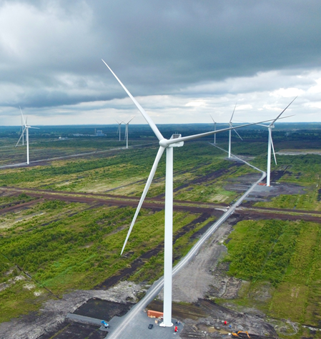
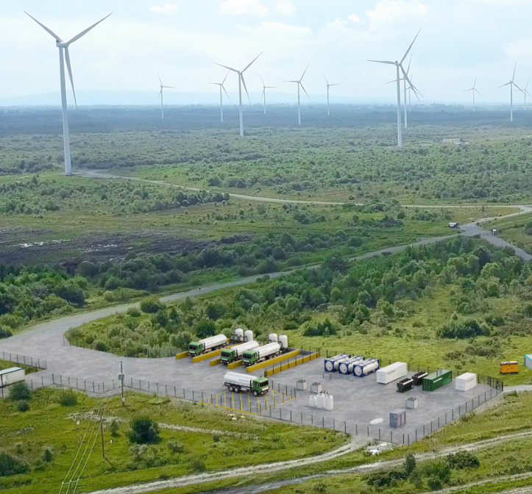
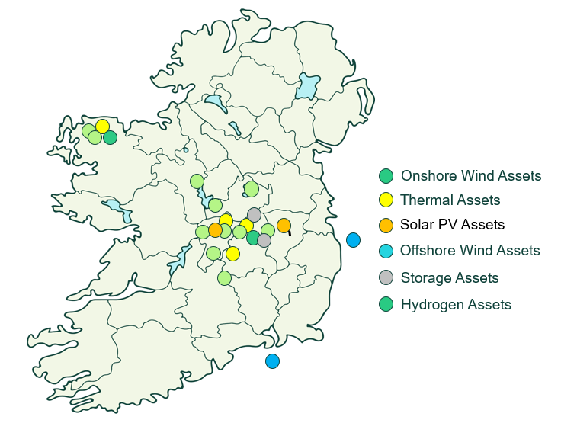
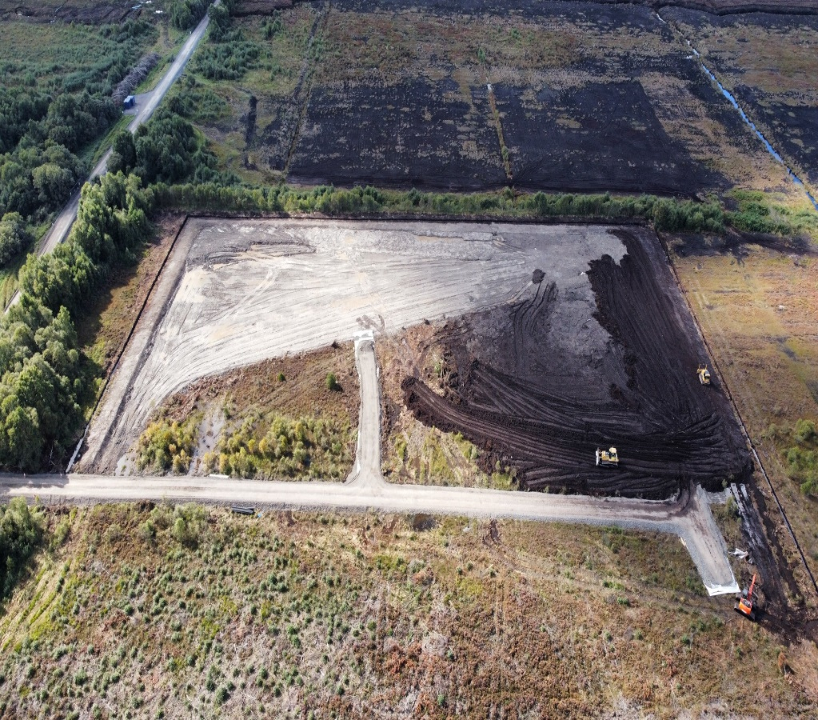
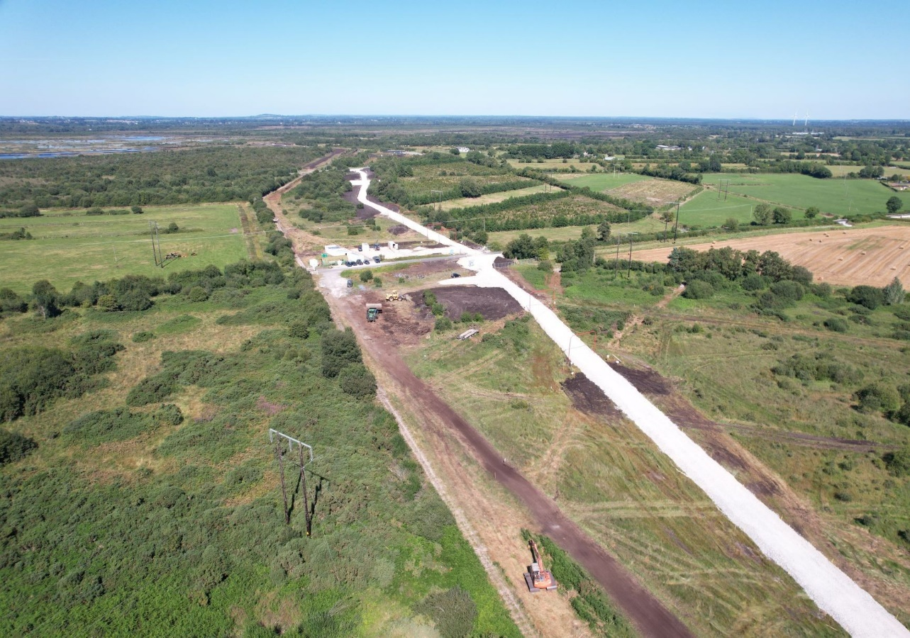
One of Ireland’s leading Renewable Energy Companies
Mt Lucas H2
2MW Electrolyser Project
Cloncreen
75 MW WF
Energised in 2022
Derrinlough
126 MW WF
Construction commenced in 2022
Timahoe North
70 MW Solar Farm
Construction commenced in 2022
Bord na Mona Projected 2030+ portfolio
950 MW of Assets Under Management
5 GW of Assets Under Active Development
~20-25%
of Ireland’s 2030 Electricity Requirement

Slide 20
Green Hydrogen

Slide 21



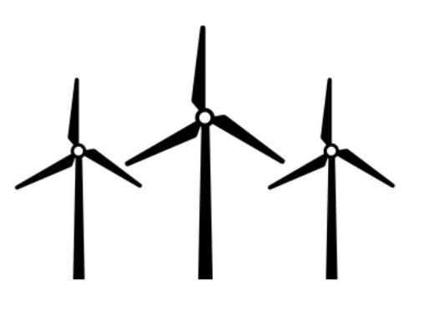


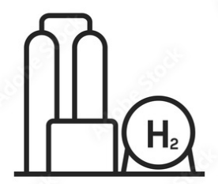




Green Hydrogen Process
Industrial demands
Mobility (HGV, buses, trains etc.)
Electricity Generation (Energy Storage)
Renewable
Electricity Production
Electrolysis
H₂ Storage
Routes to Market

Slide 22












Benefits of Green Hydrogen
H2 Value Added Products
Export
Reduce Pressure on Electricity Grid
Green Gas required for Net Zero
“Dunkelflaute” Events
New Jobs
Better Use of Curtailed Energy
Seasonal Energy Storage
Energy Security
Grid Stability
Large Storage Volumes
Utilise Existing Infrastructure
Align with EU Legislation

Slide 23













Hydrogen Routes to Market
Industrial processes
Now
(low demand)
Road mobility
Now (small scale)
~ 2030 medium scale
Energy storage
Hard to abate mobility
Grid injection
~ 2030
Export
Agriculture
~ 2030 small scale
~ 2035
~ 2035

Slide 24


National Hydrogen Strategy
4 key end-uses:
Heavy goods transport
Decarbonising industrial processes
Dispatchable flexible electricity & long duration energy storage (inter-seasonal)
E-Fuels

Slide 25
Hydrogen Projects & Energy Parks

Slide 26

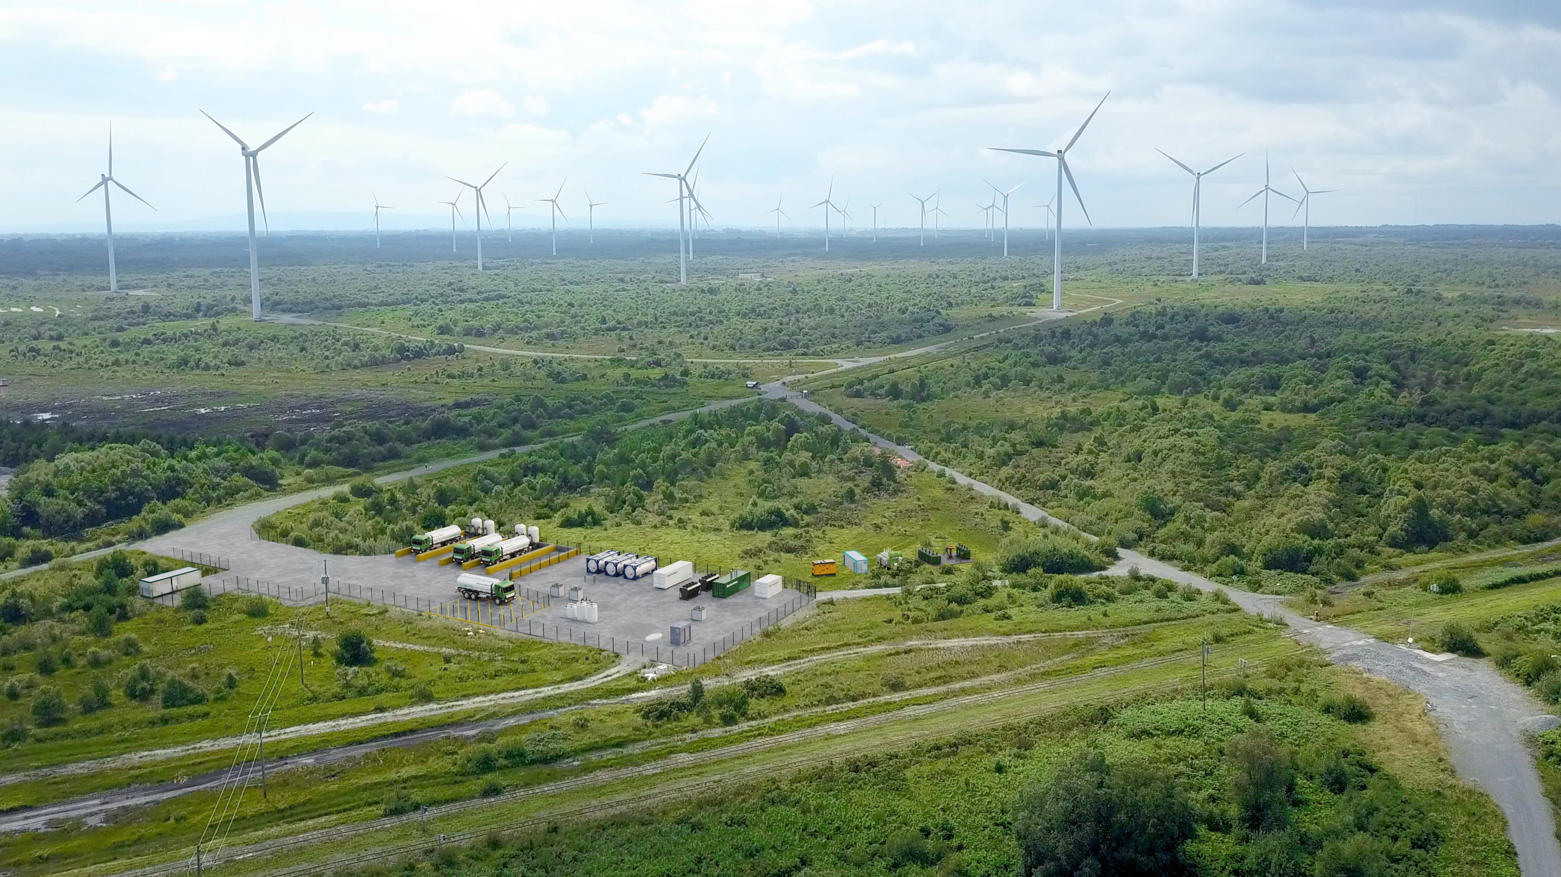
Phase I: Mt Lucas Hydrogen Project
The pilot project is a 2 MW electrolyser at our existing Mt Lucas windfarm.
The planning stage design phase has been completed; some preparation works have started.
Planning Consent received in May 2023.
Procurement of electrolyser to start shortly due to long lead times for electrolysers.
Bord na Móna is currently aiming for production of green hydrogen in 2025.
The project would produce 200,000 kg of green hydrogen per year.
The hydrogen produced will be used in the mobility sector.

Slide 27




Bord na Móna’s Mt Lucas pilot project will produce 200,000 kg/a of Green H₂.
And, if used to replace diesel, would result in up to 2,500 tonnes of CO₂ savings per year.

Slide 28
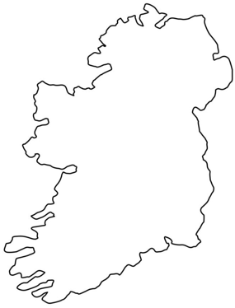


Phase II & III Hydrogen Projects
H2 integrated in Energy Park & hydrogen pipeline injection
Production of hydrogen for back-up generation and hydrogen pipeline injection
E-fuels production Project (onshore)
Production of hydrogen value added products such as e-methanol, SAF, green ammonia etc.
H2 integrated in Energy Park
Production of hydrogen for flexible generation, back-up generation, hard to abate industry
E-fuels production Project (offshore)
Production of hydrogen value added products such as e-methanol, SAF, green ammonia etc.
(location to be determined)
Phase II
Phase III

Slide 29

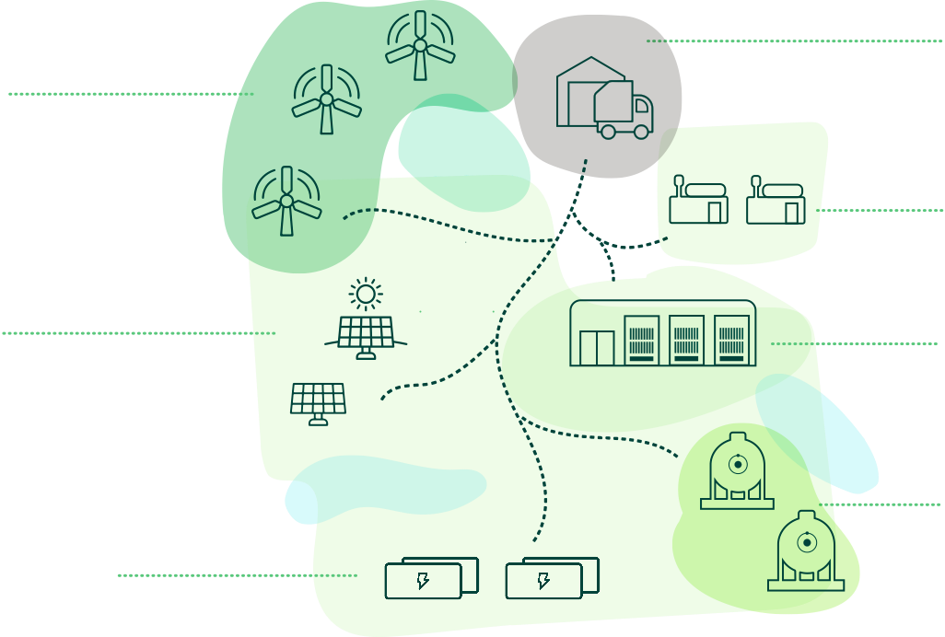
Bord na Móna Energy Park Concept
Distribution Centre
Large user of energy that requires energy, land and access to the national motorway network.
Wind Energy
Using Ireland’s abundant wind resources to generate renewable energy.
Flexible Technology
Provides a rapid response at times of peak energy demand.
Solar Energy
Solar photovoltaic panels using direct and indirect sunlight to generate electricity.
Data Centre
Key cyber economy infrastructure that requires large amounts of energy.
Hydrogen
Electrolyzer powered by renewable energy creates clean renewable gas, a largescale energy storage solution.
Battery Energy Storage
Excess renewable energy stored for use when required.

Slide 30


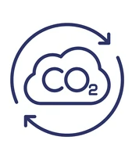
Sustainable Aviation Fuels Project
Green Hydrogen
Onshore Wind
SAF
Waste
Heat
SAF Production
Plant
Biogenic
Carbon
Edenderry (100% Biomass)
+
Carbon Capture Plant

Slide 31
Spine H2-IRL Webinar
Friday, September 15, 2023

Slide 32
About Energy Reform
Introduction
Energy Reform is a boutique consultancy with over 25 years' experience providing advanced modelling services and advice in support of the energy transition.
History
Born out of the leading-edge research at the Electricity Research Centre, headed by Professor Mark O’Malley at University College Dublin, Energy Reform has built a strong reputation for applying leading edge research in the area of renewables and energy system integration to real world problems.
Highlights
ER has been involved in numerous groundbreaking studies examining the impacts of high-RES-E scenarios in power and energy systems worldwide including the all-Island grid study and TSO facilitation of renewables study
Represents Ireland on IEA Wind Task 25, “The design and operation of power systems with large amounts of variable renewable power” and co-authored best practices for renewable integration studies
US Department of Energy Wind Research Program Peer Reviewer since 2016
We have carried out numerous innovative modelling studies demonstrating the value of flexible technologies in supporting the energy transition resulting in over €115m grant funding for our clients
Member of the research council of the Global Power System Transformation (G-PST)

Slide 33



Spine H2-IRL Project Overview
Explore the potential role of Hydrogen in the Irish energy sector
Identify viable Hydrogen development pathways for Ireland
A focus on adequacy
  Security of Supply
  Resiliency
  Flexibility
  Network Infrastructure

Slide 34
Spine H2-IRL Project Overview
WP2
Scenario Development
Detailed technology assessments will be completed, and end use scenarios will be explored as part of the Scenario Development
Expand existing models / develop new models
Modelling will provide valuable insights, highlighting optimal key investment decisions for a range of scenarios
Open Models – available to Irish researchers, facilitating further innovation and work on the energy transition
WP3
Open Model & Tool Development
WP4
Modelling of Green Hydrogen

Slide 35





Background -
Modelling of the energy transition requires more data, produces more data, modelling tasks are more complex, and models need to capture more detail
Spine:
Open source energy systems modelling framework
Designed from the ground up to address the workflow and modelling requirements of the energy transition. In particular
  Manage large data sets and complex workflows in a coherent and repeatable way
  Model more scope
  Capture more detail
  Easily add new technologies not yet thought of

Slide 36

Relevant Research Projects
Open-source toolbox for modelling integrated energy systems
Comprehensive, fast, user-friendly and thoroughly validated open-source energy system planning framework
Ran from 2017 to 2021
5 Partners
Budget €4m over 4 years.
From 2023 to 2027
15 Partners
Budget €6m over 4 years.

Slide 37


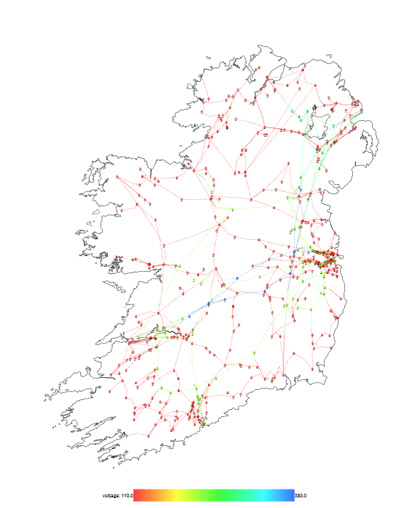
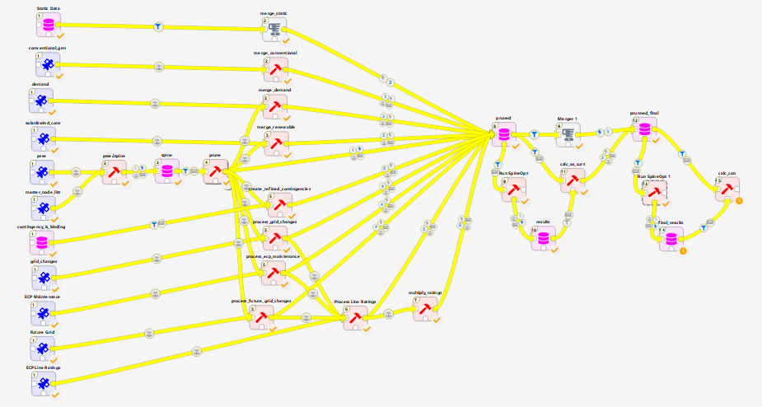
The Spine Open-Source Framework for Energy System Modelling
Comprehensive multi-tool and workflow management
Richly featured and uniquely flexible energy system model
SpineOpt CAES Model
SpineOpt Irish Grid and Market Model
Create and manage coherent, repeatable, complex workflows
Manage, convert and manipulate data
Store and access data in a centralised, problem independent
Link models
Flexible structure allows technologies to be represented at an arbitrary level of detail
Uniquely flexible approach to time and uncertainty giving finer control of model dimensions
Methodologies to capture more scope and more detail
Co-optimise investments, markets, operations and grid

Slide 38
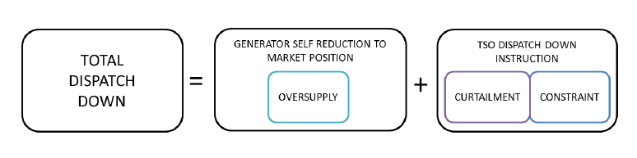
Example Spine Workflow
Programmatic creation of combined market and grid model and calculation of oversupply, curtailment and constraint
Validation against EirGrid ECP 2.1 Constraint Report results

Slide 39

Background – Case Study C3
Explored pathways for Hydrogen investments in the Irish energy system
Focus on long-term hydrogen storage (demonstrating capabilities of SpineOpt)
Six different scenarios explored
  Global Ambition (GA)
  High Fuel Price (HFP)
  Hydrogen Network (HN)
  Technology Breakthrough (TB)
  High Variable Renewables (VRE)
  Restricted CAES (RC)

Slide 40
SpineOpt Model Implementation Details
Detailed representation of plants
  Minimum generation levels
  Minimum up and down times
  Incremental heat rates
  Reserve capabilities
Approximate models of GB and France to facilitate modelling of interconnector flows
System level Inertia floor and reserve requirements (POR & TOR)
4 different types of storage (3 investment options)
  Pumped Hydro Storage
  Compressed Air
  Hydrogen Storage
  Batteries
Investment variable
Implementation of hydrogen-fuelled compressed air energy storage in SpineOpt using the fundamental building blocks of units and nodes

Slide 41
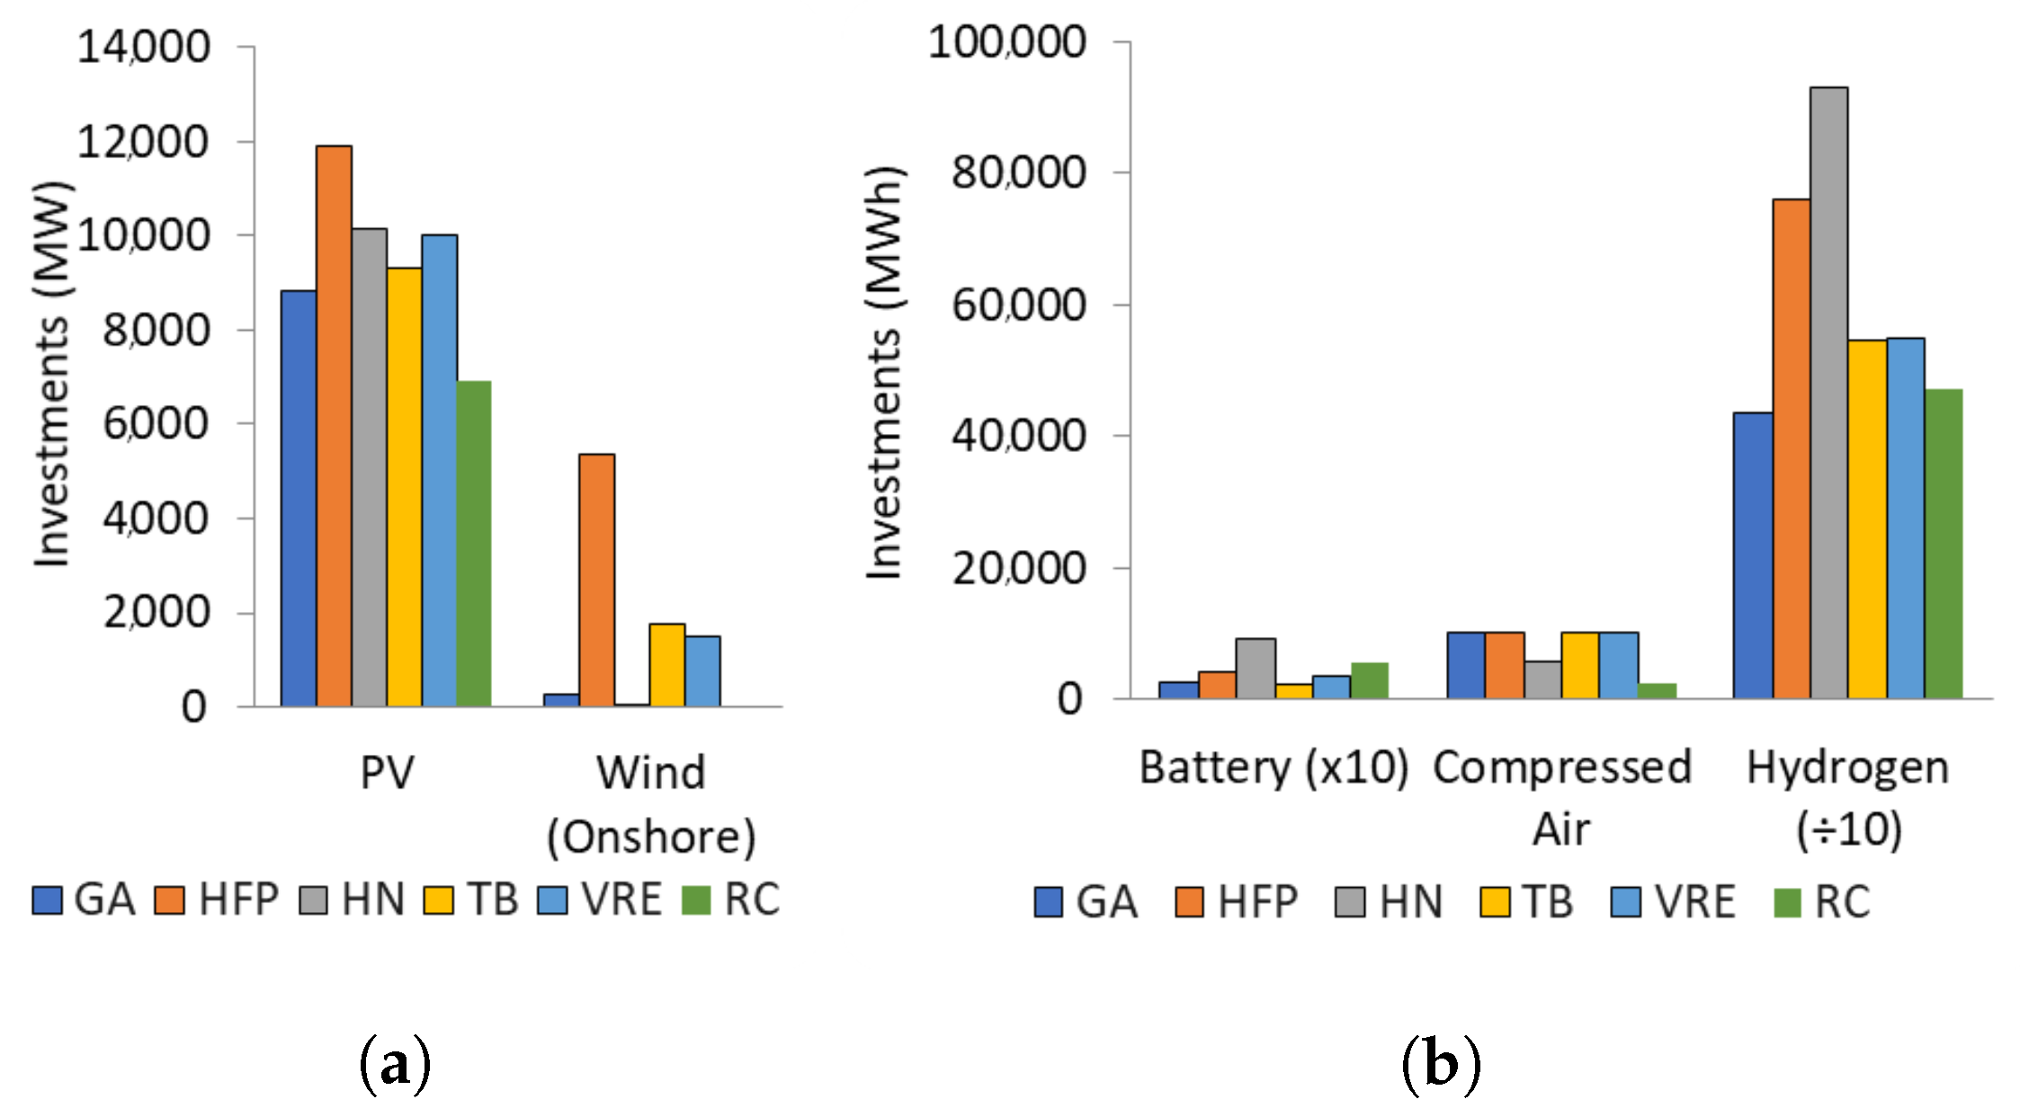
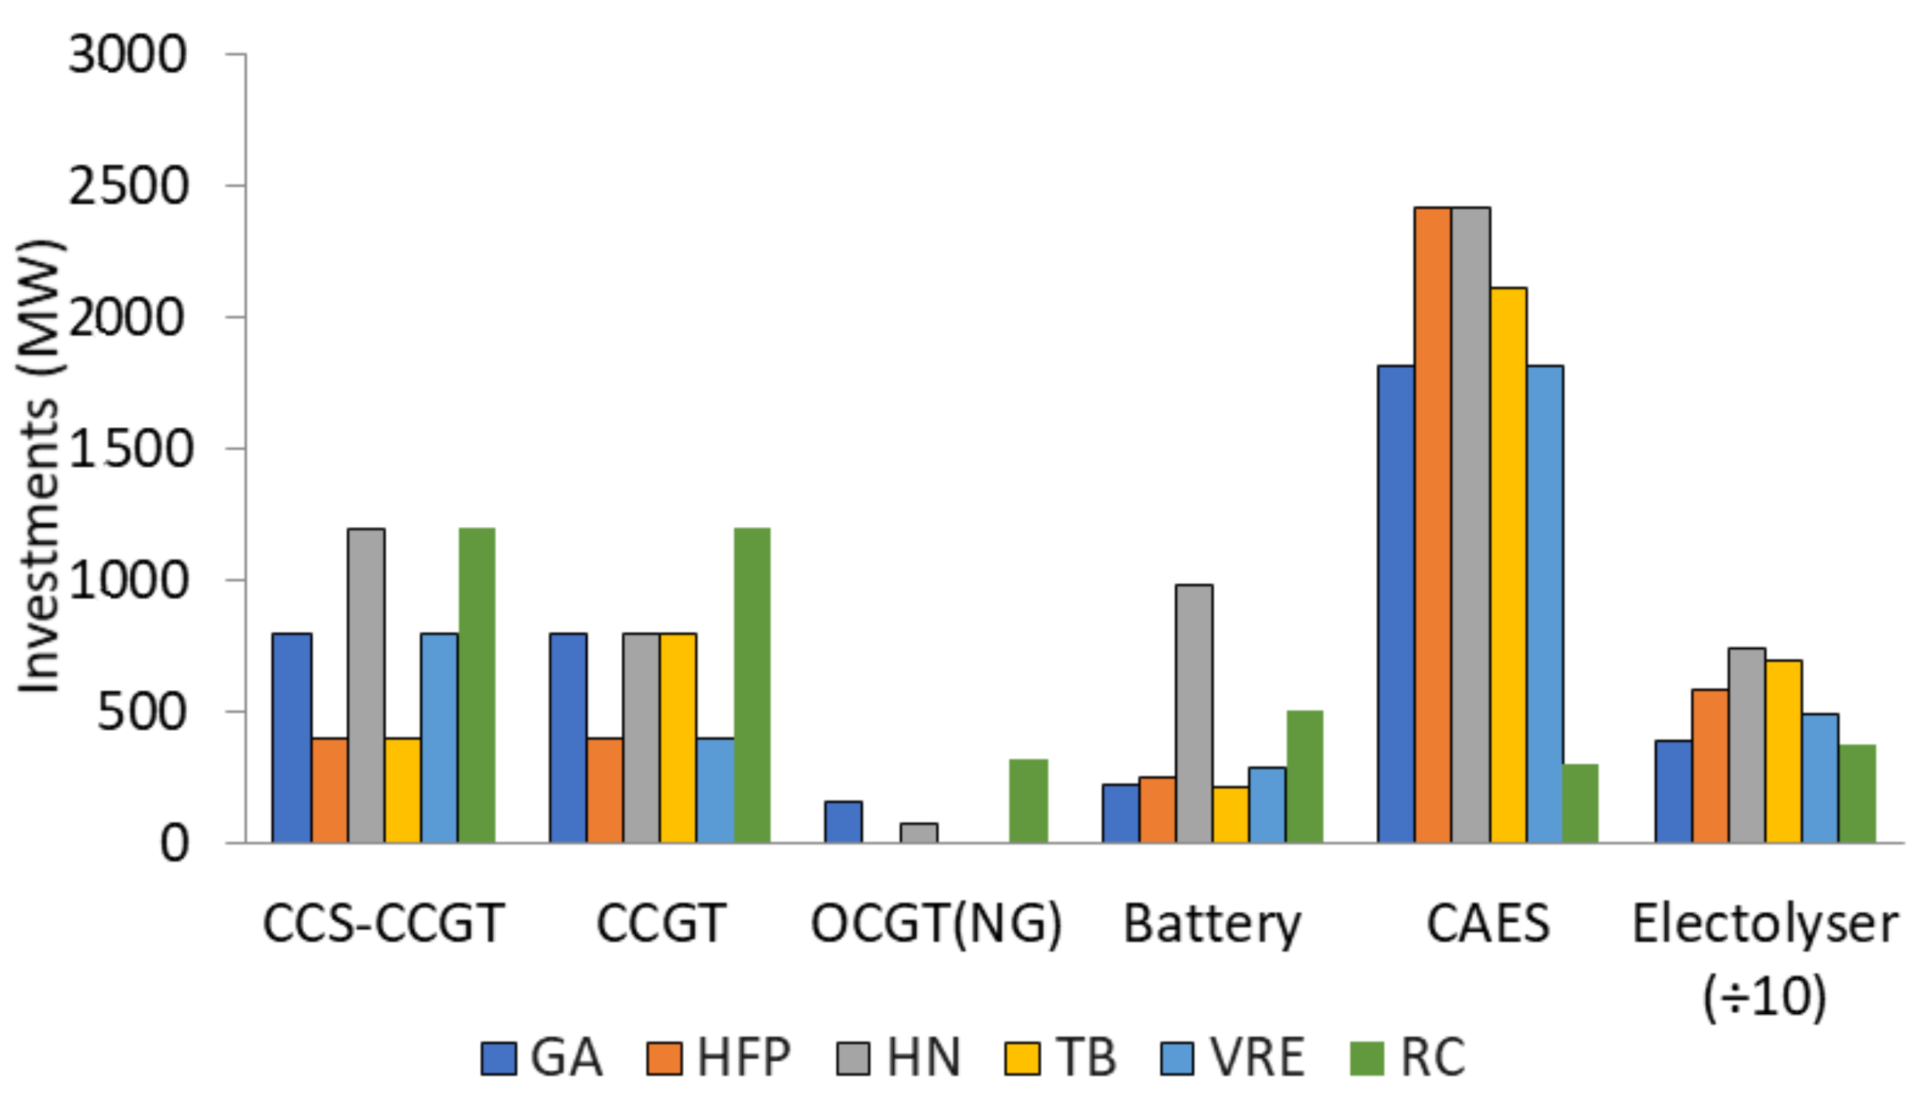
C3 Results - 2040
All scenarios see synergistic investments in variable renewables, electrolysis and hydrogen storage
When we increase fuel prices, H2 demand or reduce RES investment costs, we see more investment in H2 technologies and renewables
The most effective driver of additional on-shore wind power capacity is higher fuel and carbon prices
Modelling of flexibility requirements such as inertia and reserve increase investments of flexible plant and are important to capture

Slide 42
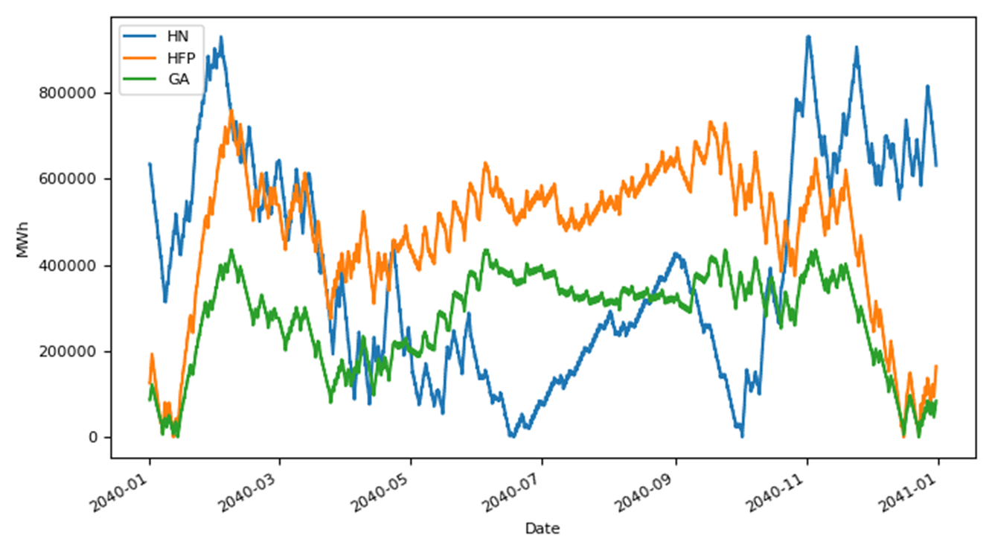
Optimising Long-Term Decisions using SpineOpt
Can’t influence long term issues (e.g. investments, storage)
No visibility of operational issues
Long term / investments model
Short term operational model
Limitations of the traditional single-pass approach:
Investments are decided based on simplified long-term model
Investment model has no visibility of operational issues like
  Congestion
  System constraints
  Flexibility needs
Operational detail can’t influence investments
Co-optimisation of short term and seasonal use of H2 storage in Spine Case Study C3, possible using SpineOpt

Slide 43




Spine H2-IRL
Build on previous work with more targeted scenarios, informed by the National Hydrogen Strategy
Expand existing Spine models to ensure system flexibility requirements and network constraints are adequately considered as part of the long-term pathways model
Develop new capabilities within Spine to enable comprehensive reliability assessments

Slide 44


Scenario Development
Technology Assessment
  Consider the costs and characteristics of existing / future technologies, key to an integrated hydrogen energy system
  Including e.g. fuel cells and electrolysers, as well as retrofit of existing technologies – e.g. combustion turbines
Infrastructure Scenarios
  Transportation – pipelines / trucks
  Storage – underground / tanks
Security of Supply and flexibility service requirements
  Generic formulation that can be included in the core pathways model
Scenario Specification
  Macro level scenarios
  Future system service requirements
  Infrastructure scenarios
  Future investment costs
Methodology, Assumptions & Data
  Data requirements defined
  Sources identified

Slide 45

Scenario Development – National Hydrogen Strategy
Provides valuable insights for the creation of credible scenarios
Key end-uses and timelines outlined
Important infrastructure options and timelines outlined
Significant uncertainties highlighted

Slide 46
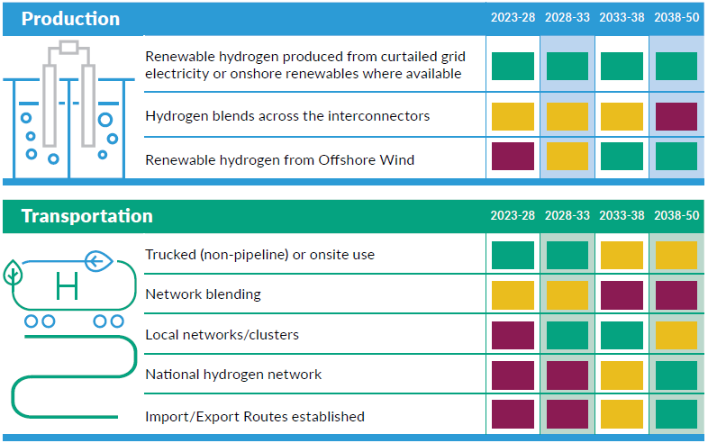
National Hydrogen Strategy
Production from both curtailed grid electricity and dedicated offshore hydrogen will be embedded in the model, with investment options for both additional electrolysers and renewable generation
Local clusters can be modelled in detail, with the expansion to a national network included as an investment option
Road transport options and import / export may also be included

Slide 47
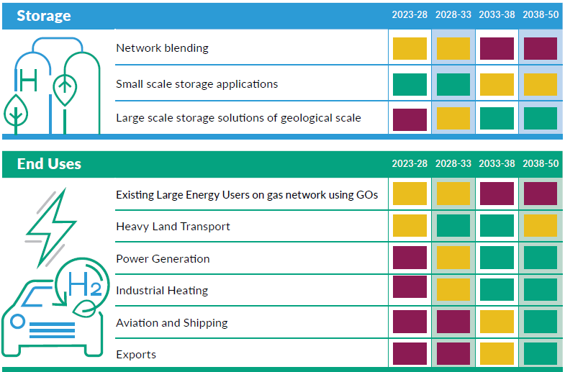
National Hydrogen Strategy
Small scale tanks large-scale underground storage can both be included as investment options
Power generation will be included as an investment option (retrofit?) and demand will be endogenous
Other end-use demands and locations will need to be estimated as part of the scenario building exercise, and will likely form a number of alternative scenarios

Slide 48
National Hydrogen Strategy
Uncertainty surrounding levels of domestic demand, as well as the potential for export will require alternative scenarios with different levels of demand

Slide 49
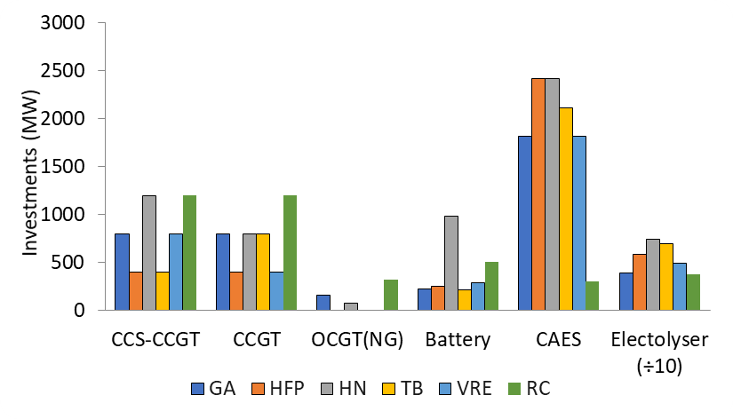
Spine Models
Electricity Grid and H₂ Network Model
Reliability Model
Power market modelling with full transmission representation including N-1 secure dispatch and commitment. Replicate oversupply, constraint and curtailment results in arbitrary future scenarios
Development of models and tools to study energy system reliability. E.g. capacity outage probability table approach and Monte-Carlo-based methods
Typical capacity outage probability table result
Combined grid and market model
Typical capacity outage probability table result
Flexibility / Balancing Model
Pathway Model
Modelling of day-ahead, intraday and balancing markets across Europe for revenue forecasting across multiple markets and value estimation for financing and grant support
Modelling of the evolution of the energy system to achieve high-level targets such as decarbonisation and renewable transition.
Modelling of day-ahead, intraday and balancing market
Role of Hydrogen-based technologies in the future Irish system

Slide 50



Spine Models
Electricity Grid and H₂ Network Model
Flexibility / Balancing Model
Pathway Model
The core model for delivering the WP4 assessments and the final report is the Pathway Model
Develop Network Model & Balancing Model which can be incorporated into the Pathway Model
The aim is to include as much detail as possible while managing model size
Security of supply and reliability requirements will also be incorporated into the Pathway Model
Dedicated security of supply analysis will be carried out on the resulting portfolios from the Pathway Model, using the Reliability Assessment Model
Reliability Model

Slide 51
Spine Models
Electricity Grid and H₂ Network Model
Flexibility / Balancing Model
Pathway Model
The core model for delivering the WP4 assessments and the final report is the Pathway Model
Develop Network Model & Balancing Model which can be incorporated into the Pathway Model
The aim is to include as much detail as possible while managing model size
Security of supply and reliability requirements will also be incorporated into the Pathway Model
Dedicated security of supply analysis will be carried out on the resulting portfolios from the Pathway Model, using the Reliability Assessment Model
Reliability Model

Slide 52
Spine Models
Electricity Grid and H₂ Network Model
Flexibility / Balancing Model
Pathway Model
The core model for delivering the WP4 assessments and the final report is the Pathway Model
Develop Network Model & Balancing Model which can be incorporated into the Pathway Model
The aim is to include as much detail as possible while managing model size
Security of supply and reliability requirements will also be incorporated into the Pathway Model
Dedicated security of supply analysis will be carried out on the resulting portfolios from the Pathway Model, using the Reliability Assessment Model
Reliability Model

